Slide 1
SharePoint Social Networking

Slide 2
Agenda
The Purpose of Blogs and Wikis
Default Blog Sites and Wiki Libraries
Adding Posts to Blogs
Adding Pages to Wikis

Slide 3
The Purpose of Blogs and Wikis
Foster candid communication
Encourage creativity and individuality
Offer easy modification to a web page
Promote feedback
Notes:
Today’s technology makes it possible to store an abundance of data. But in order for a company to effectively use that data in making smart decisions, human information workers must be able to process the data and apply it effectively to challenges they face. In the early stages of planning appropriate data consumption a less formal means of communication and presentation can prove highly productive. During the process of working with business data an informal method of communicating with coworkers, collecting feedback, and presenting ideas gives users the chance to be creative and think beyond current business practices.
SharePoint 2010 offers blogs and wikis as two social networking tools intended to encourage casual brainstorming and candid communication of ideas by team members. Both are long-familiar technologies on the Internet that have been available in SharePoint since 2007. Blogs allow one or multiple business users to post blog entries and optionally receive comments from the blog’s readers. Wikis are used to create loosely linked web pages that can be populated with a variety of content such as text, pictures, graphics, hyperlinks, and more. In fact, most of the site templates used in SharePoint 2010 are based on wiki sites to make editing their web pages easier.
Blogs and wikis address the following business needs:
Candid Communication: foster straightforward discourse and inventive thinking
Creativity and Individuality: boost sense of ownership and creative freedom
Easy Modification: provide simple, intuitive interfaces for editing web pages
Feedback: promote sincere responses from readers
NOTE: some users and administrators may have the perception that blogs and wikis can be dangerous due to their casual nature, but SharePoint offers content approval features to moderate the information being posted so you can be certain inappropriate comments or topics are removed.

Slide 4
Agenda
The Purpose of Blogs and Wikis
Default Blog and Wiki Sites
Adding Posts to Blogs
Adding Pages to Wikis

Slide 5
Default Blog and Wiki Sites
Blog Sites
Wiki Libraries
Wiki Sites
Notes:
SharePoint 2010 offers default templates for hosting a blog or wiki on a community site. In fact, many of the site templates themselves are actually wiki sites that provide simpler, more intuitive editing methods for site administrators and designers. Blogs are constructed by site administrators as subsites, while Wikis can be either a library or a subsite of the community site.
Determining the best location for a blog or wiki depends on which users will be responsible for writing it and which users will read it. Exposing a blog to its audience is simply a matter of redirecting the readers to the blog site via a hyperlink or exposing the blog site using a web part. Either way, the site administrator can make it possible to post to the blog, read it, and post comments without leaving the blog’s parent site. Once a blog (site) is created, the site’s administrator will use permissions to restrict who can read, post and comment on the blog. Some blogs have multiple users who post, often referred to as a “team blog”.
Wikis, on the other hand, can be constructed either as a library in an existing SharePoint site or as an entirely separate site. Site designers will choose between a wiki library and a wiki site based on factors such as who will be contributing to the wiki, who will be reading it, who will moderate the wiki (if an approval process is necessary for new content), and who will administer the wiki. Again, the site administrator will use permissions to restrict user access to the wiki where such limits are necessary. Accessing a wiki library on a SharePoint site is essentially like accessing any other library. There will be a hyperlink to the library in the All Site Content link of the Quick Launch Bar on the site and there may even be a link to the wiki in the Quick Launch Bar itself (depending on how the library is configured). Site designers may provide additional navigational items to make accessing the wiki very easy.
A wiki site is an entirely separate SharePoint site and depending on the design of your SharePoint environment may require auxiliary navigation links to access. Once logged onto a wiki site, the editing and creation of pages is performed by adding pages to the site. This is a function normally reserved for users with elevated privileges to the site, which many site administrators prefer to limit to a handful of people. For this reason, wiki sites are a viable alternative to wiki libraries when there are going to be few authors of the wiki pages and the authors have been trained on site maintenance.

Slide 6
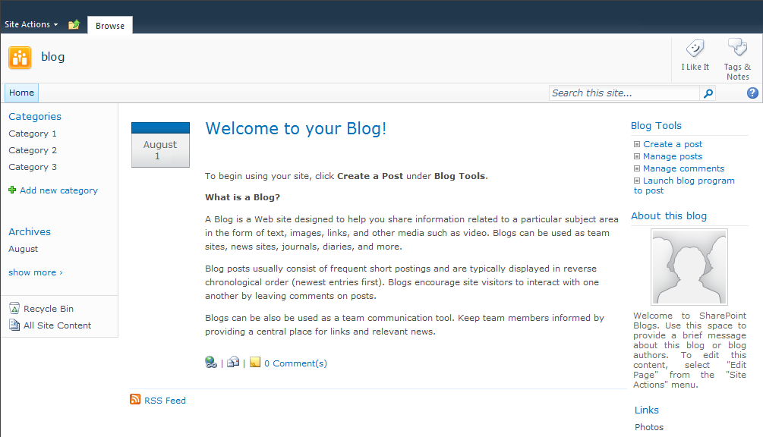
Blog Site
Notes:
Blog sites offer several features for getting your message out to your readers. First and foremost, your blog entries appear in chronological order from newest down to oldest right on the default (main) page of the site. All readers need to do is visit your blog site’s URL and they immediately can begin reading your entries. These entries are called Posts and the act of writing a post to a blog is often referred to as posting to the blog. The main features of a blog site include:
Some blog sites are set up to allow multiple business users to post to the blog. When there are multiple users writing blog entries it is important to make sure post topics other than editorial commentary, such as notices or announcements, are not duplicated. This can be accomplished by a blog moderator. SharePoint blog sites include a list called Posts where the post entries are stored. Like any other list, this list can be configured by its list administrator to require content approval via the list configuration setting or a workflow.

Slide 7
DEMO
SharePoint 2010 Blogs
Notes:
In this demonstration, your instructor will tour a default blog site and point out the features.

Slide 8
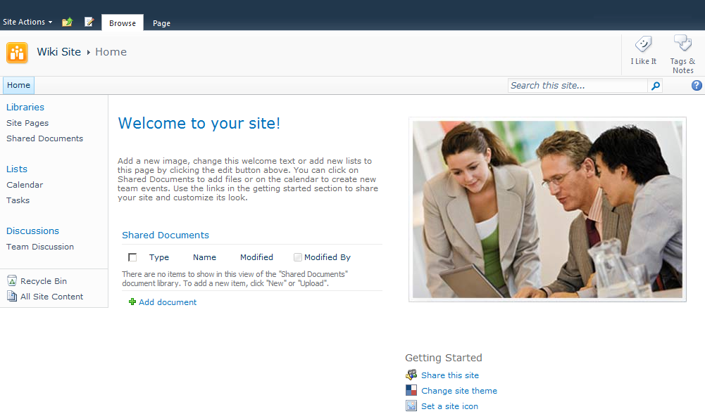
Wiki Site
Notes:
Wiki sites are sometimes used as collaboration sites, such as with the commonly used Team Site default template in SharePoint 2010. By managing the site pages as a wiki rather than as disconnected individual web pages, these sites provide an easier and more streamlined editing process than traditional web page files. The site becomes nothing more than a site which manages all of its pages in a library that was built from the wiki library template.
There are two ribbons you may encounter when working with a wiki site. The first is the Page ribbon available while viewing the page normally. This ribbon can be used to view all pages in the wiki library on the site, which will display a table format of the wiki library. You can even use the Income Links to identify which other wiki pages on the site link to the page you are viewing.
NOTE: It may be difficult to tell a wiki site from a traditional SharePoint site. If you have been granted the ability to edit pages on your site and notice that the practice of enclosing another page’s title in double square brackets (i.e. [[Page 2]] ) automatically generates a hyperlink to that page, then you are on a wiki site. If you visit the Site Pages library on a team site or click the View All Pages link from the tool bar above and notice that there is a Home and a “How to Use This Library” page, you are most likely on a wiki site.

Slide 9
DEMO
SharePoint Wiki Sites
Notes:
In this demonstration, your instructor will tour a wiki site and point out the features.

Slide 10
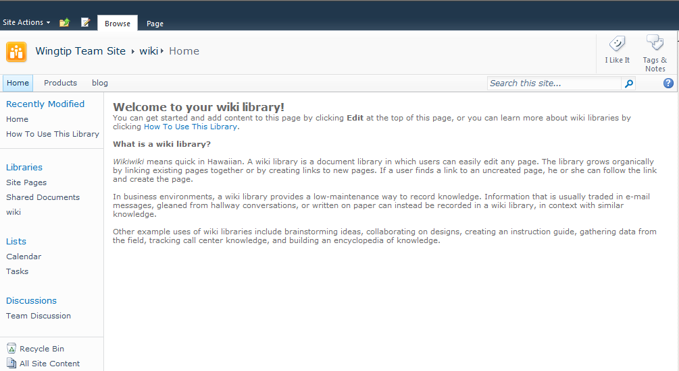
Wiki Library
Notes:
Wiki libraries are useful when a site administrator wants to add an informal documentation tool to the site without adding the burden of extra site management. Like many other library templates, the wiki library template offers similar library configuration settings that can be set by the library administrator, such as searchability, content approval, check-out and version control. In fact, the wiki template engages Major Version control by default to allow users to restore wiki pages to previous versions!
However, unlike many other library templates, wiki libraries are designed to hold only one item content type: a wiki page. And when a business user navigates to the wiki library, the library is not displayed in the typical table structure with each item appearing as a row like the default view of other library templates. Instead the Home page item in the wiki library is rendered as a web page. All new wiki libraries contain a Home page and a page entitled “How to Use This Library”. The second page can be used as a tutorial to learn how to add new pages or edit existing pages in the library. Because the library is not presented to users in a table format, it is imperative that page contributors provide links on their pages that navigate out to other pages in the library. This informal path chain makes it easier for readers to navigate from one page to other related pages along the same topic or business process.

Slide 11
DEMO
SharePoint Wiki Libraries
Notes:
In this demonstration, your instructor will tour a wiki library point out the features.

Slide 12
Agenda
The Purpose of Blogs and Wikis
Default Blog and Wiki Sites
Adding Posts to Blogs
Adding Pages to Wikis

Slide 13
Adding Posts to Blogs
Add item to Posts list on blog site
Use SharePoint editor
Use a custom editor
Categorizing your post
Moderated blogs
Notes:
SharePoint offers several ways to add and control posts to a blog site:
Posts List – simply add a new item to the Posts list like you would add items to any other list and fill in the fields
SharePoint Editor – used to add or edit posts, SharePoint provides a rich text editor for writing post content
Custom Editor – there is a link on the blog site entitled Launch Blog Program to Post that will launch your pc’s default blog editing application (NOTE: this will require you to register your SharePoint blog site’s URL with your blog editing application)
Assign Category – during post creation with the SharePoint Editor or after a post exists (no matter how it was created) the Category field can be filled in with one of the titles from the Category list to classify the post.
Approval – if the blog is moderated, your new post may remain in a Pending status in the Posts list until the moderator approves it (after which time it will be viewable to blog readers).
While SharePoint provides a basic post editor window with rich text format capability, some serious bloggers find this interface rudimentary and limiting. If you would like more formatting options for your posts, consider acquiring a third-party blog editing application and use the Launch Blog Program link instead.

Slide 14

Interacting with Blogs
Email Link to a Post
Permanent Link to Post
Post a Comment
Number of Comments
Subscribe to the blog
Notes:
As a blog reader, you have several tools on a SharePoint blog site that can help you interact with the posts. Each post provides the following links:
Permanent Link to Post – represents the URL to the individual post item from the Posts list (you can copy this icon’s shortcut to paste anywhere you want to create a hyperlink straight to the post itself)
Email Link to a Post – launches your default email client application and automatically includes a hyperlink to the post in the message body
Number of Comments – reflects the total number of comments that have been made on the post
Comment(s) – click this link to write a comment about the post
In addition to post-specific tools, the blog as a whole offers a RSS Feed hyperlink that allows you to subscribe to the RSS feed of the blog (you can then use a RSS reader of your choice to view the feed):

Slide 15
DEMO
Working With SharePoint 2010 Blogs
Notes:
In this demonstration, your instructor will illustrate how to:
Post a blog entry.
Categorize a blog entry.
Comment on a blog entry.
Mark a blog entry for easy return.

Slide 16
Agenda
The Purpose of Blogs and Wikis
Default Blog and Wiki Sites
Adding Posts to Blogs
Adding Pages to Wikis

Slide 17
Adding Pages to a Wiki Site
Site Actions – New Page
Site Pages Library – New Item
View All Pages – New Item
Create a new page or edit an existing page?
Comment topic is already discussed on existing page
Existing page has available space
Existing page is already logically linked appropriately for new narrative
Existing page is already secured appropriately for new narrative
Notes:
The process of creating and editing wiki pages is similar for both wiki sites and wiki libraries. However the links from which wiki pages can be added and edited may appear differently depending on whether you are contributing to a wiki site or a wiki library.
On a wiki site, you contribute to the wiki by contributing pages to the site’s wiki pages library. Depending on the site template used to create the site the wiki pages library may be called Site Pages or it may have been titled by its creator using a custom name. Either way, what is interesting to note is that business users who have at least the Contribute permission to the wiki pages library on the site can add pages to the wiki site even if they have not been additionally granted the Site Permission called “Add and Customize Pages”.
There are multiple methods you can employ to add a new page to a wiki site:
Site Actions Menu Wiki Pages Library Wiki Page (then Library Tools)
Consider carefully before creating an entirely new wiki page. If your commentary is related to an existing page with available room, you may choose to simply edit the existing page instead. Creating additional pages on a wiki site increases site size exponentially because space is needded for the metadata that must be maintained about the new page in addition to the space required for its content. It also requires additional site administration and maintenance.

Slide 18
Adding Pages to a Wiki Library
Wiki Page Library – New Item
View All Pages – New Item
Notes:
In a sense, whenever you add pages to a wiki site you are actually adding the new page to that site’s wiki library. Therefore adding pages to a wiki library on an existing site (whether that site is a wiki site or another type of site template) is almost the same process.
However, if the wiki library is being hosted on a non-wiki site, you will not be adding pages to the site itself but rather you’ll be adding items to that site’s wiki library. This is an important distinction because on non-wiki sites, the privilege of adding pages to the site using the New Page choice in the Site Actions menu is reserved for site administrators and designers. Therefore, business users will need to exercise the New Item selection on the wiki page library to add new pages to the wiki.
Another often confused point in wiki management is the fact that a wiki library can be added to a wiki site. When a custom wiki library is being hosted on a wiki site, there are two separate wiki page libraries: the site’s wiki library itself (named Site Pages by default) and the custom wiki library named by the library designer. As a business user with at least the Contribute permission level, you will be able to add pages to both of these libraries. You will want to be sure you are adding your new page to the appropriate library based on your intended audience and the subject of your page’s content. Also, be careful not to duplicate pages in these two libraries unnecessarily as storing data in SharePoint twice violates the principle of single instance storage (discussed earlier in this course).
Just as wiki sites may contain additional custom wiki libraries, wiki sites can also be configured with subsites that use a wiki site template (which, in turn, may contain supplemental custom wiki libraries themselves). It is up to the administrators who draft your site collection design and site designs to avoid confusing nesting of multiple wikis that can result in data duplication, inefficiencies and lost productivity.

Slide 19
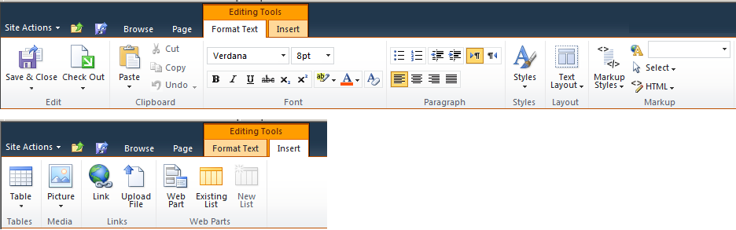
The Editing Tools Contextual Tab Group
Notes:
No matter which wiki library you are contributing to, SharePoint 2010 offers an Editing Tools contextual tab group to help you create and edit your wiki page files. The group is broken into two tabs: Format Text and Insert.
Format Text Tab
Offering clipboard, font, and paragraph sections similar to other Microsoft Office applications this familiar tab allows you to define the style of your wiki page including:
Edit: for check in/out and saving your changes
Styles: for choosing web text type such as highlighted, byline, comment or tag
Layout: for choosing page layout (column structure, header/footer sections)
Markup : for choosing text styles, language, and layout as well as allowing users fluent in HTML and XHTML to directly edit the HTML source code of the wiki page.
Insert Tab
Used to insert tables, media, links and web parts into your wiki page. Pictures must come from a file system path on your computer or from a URL to an image item in a SharePoint picture library.

Slide 20
DEMO
Interacting with Wikis in SharePoint 2010
Notes:
In this demonstration, your instructor will illustrate how to:
Access a wiki site vs. a wiki library.
Add a page to a wiki library.
Add a page to a wiki site.
Add and confirm connection links between wiki pages.
Edit and Delete wiki pages.

Slide 21
Summary
The Purpose of Blogs and Wikis
Default Blog and Wiki Sites
Adding Posts to Blogs
Adding Pages to Wikis

